Slide 1

Sprocket Central Pty Ltd
Data analytics approach
M Saranya

Slide 2
Agenda
Introduction
Data Exploration
Interpretation
Summary

Slide 3
Introduction
Identify and Recommend Top 1000 Customer to Target from Dataset
Outline of Problem
Sprocket Central is a company that specializes in high-quality bikes and cycling accessories.
Their marketing team is looking to boost business sales by analyzing provided datasets.
Using the 3 datasets provided the aim is to analyze and recommend 1000 customers that Sprocket Central should target to drive higher value for the company.
Contents of Data Analysis
Customer Density Map
Brand vs Sales
Avg vs Total Sales
Gender Contribution in Sales (Industry wise)
Average profit
Product Sold
Total Profit

Slide 4
Data Exploration
Data Quality Assessment and ‘Clean Up’
Key issues for Data Quality Assessment
Accuracy: Correct Values
Completeness: Data Fields and Values
Consistency: Values Free from Contradiction
Currency: Values up to Date
Relevancy: Data items with Value Meta-data
Validity: Data containing allowable Values
Uniqueness: Records that are Duplicated
Summary Table
 | Accuracy | Completeness | Consistency | Currency | Relevancy | Validity
Customer Demographic | DoB: Inaccurate Age: missing | Job title: Blanks Customer id: Incomplete | Gender: Inconsistency | Deceased Customer: Filter Out | Default Column: Delete
Customer Address |  | Customer id: Incomplete | States: Inconsistency
Transaction | Profit: Missing | Customer id: Incomplete Online order: Blanks Brand: Blanks |  |  | Cancelled Status Order: Filter out | Format: List Price, Product Sold

Slide 5
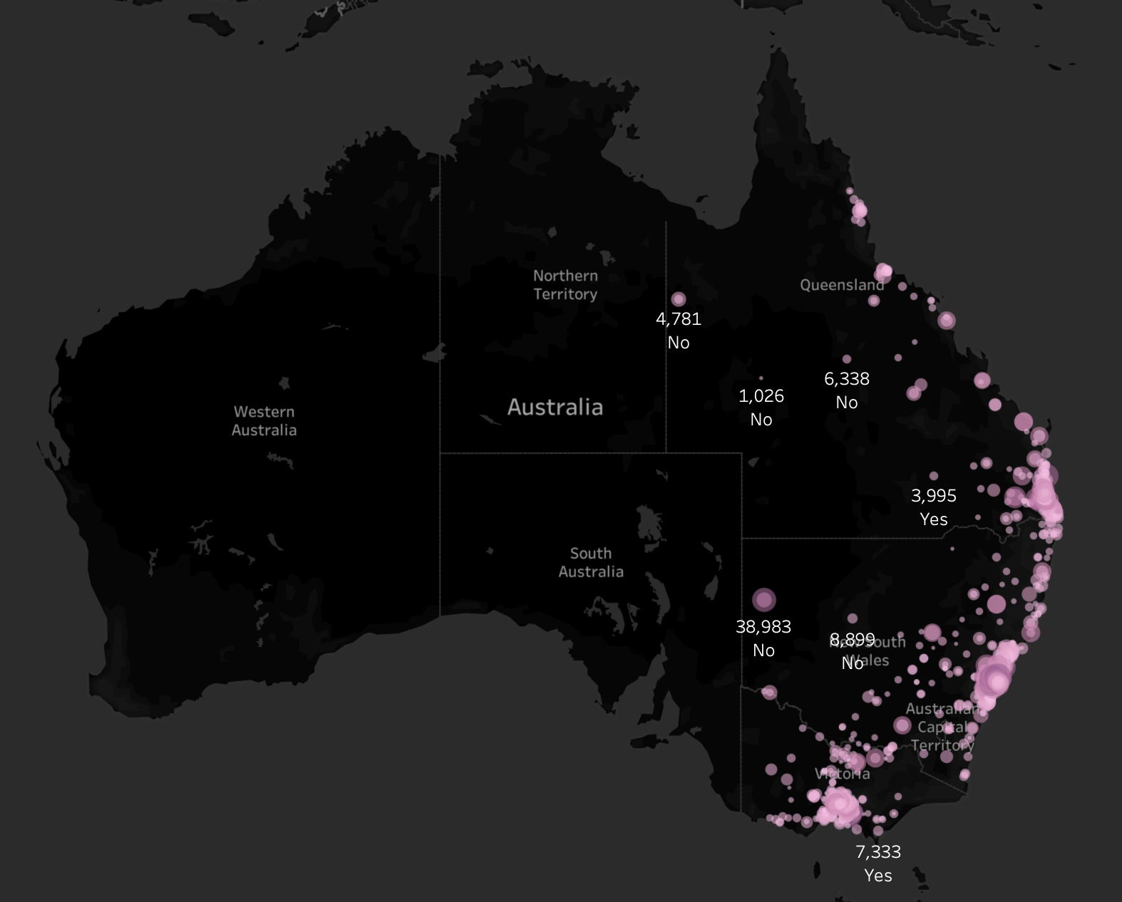
Data Exploration
Customer Density Map:
Highest sales profit in New South Wales (NSW). NWS has the largest amount of people that do not own a car. NWS seems to have higher number people from which data was collected.
Victoria sales is also split quite evenly. But both numbers are significantly lower than those of NSW.
QLD has a relatively high number of customers that own a car.

Slide 6
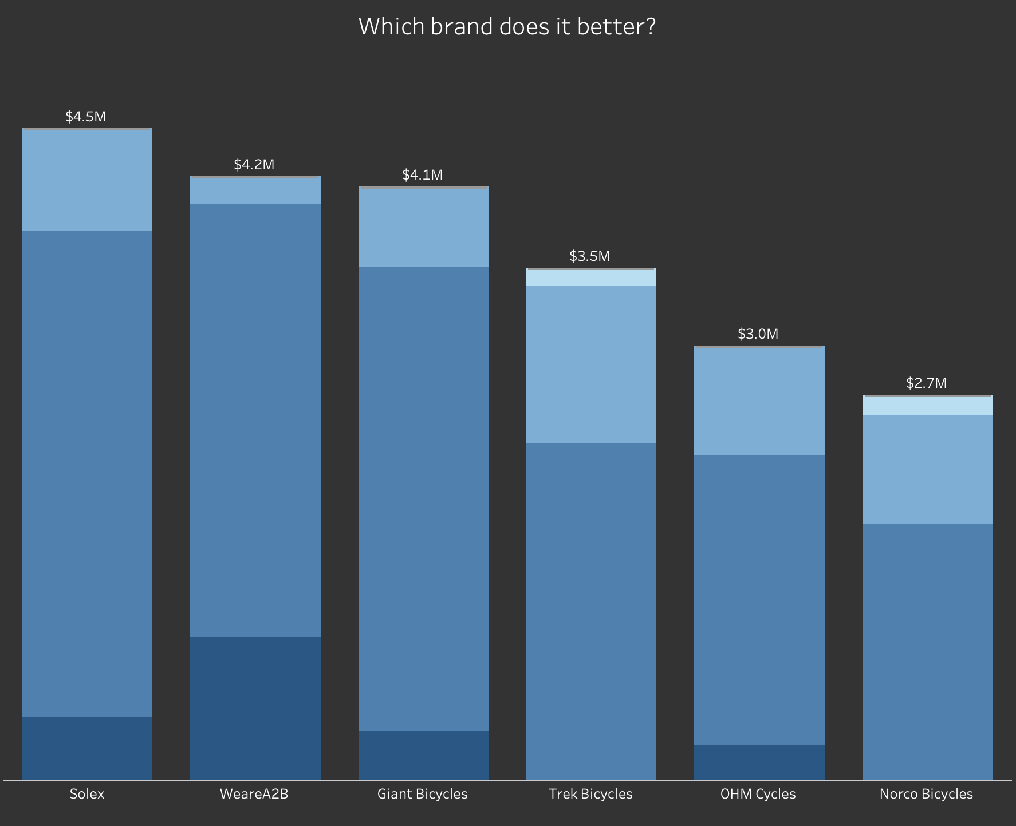
Data Exploration
Brand wise Product sales:
Most often sales in standard product line than others.
Mountain product line is significantly lower sales.
Highest sales in Solex, Giant bicycle and WeareA2B brands.

Slide 7
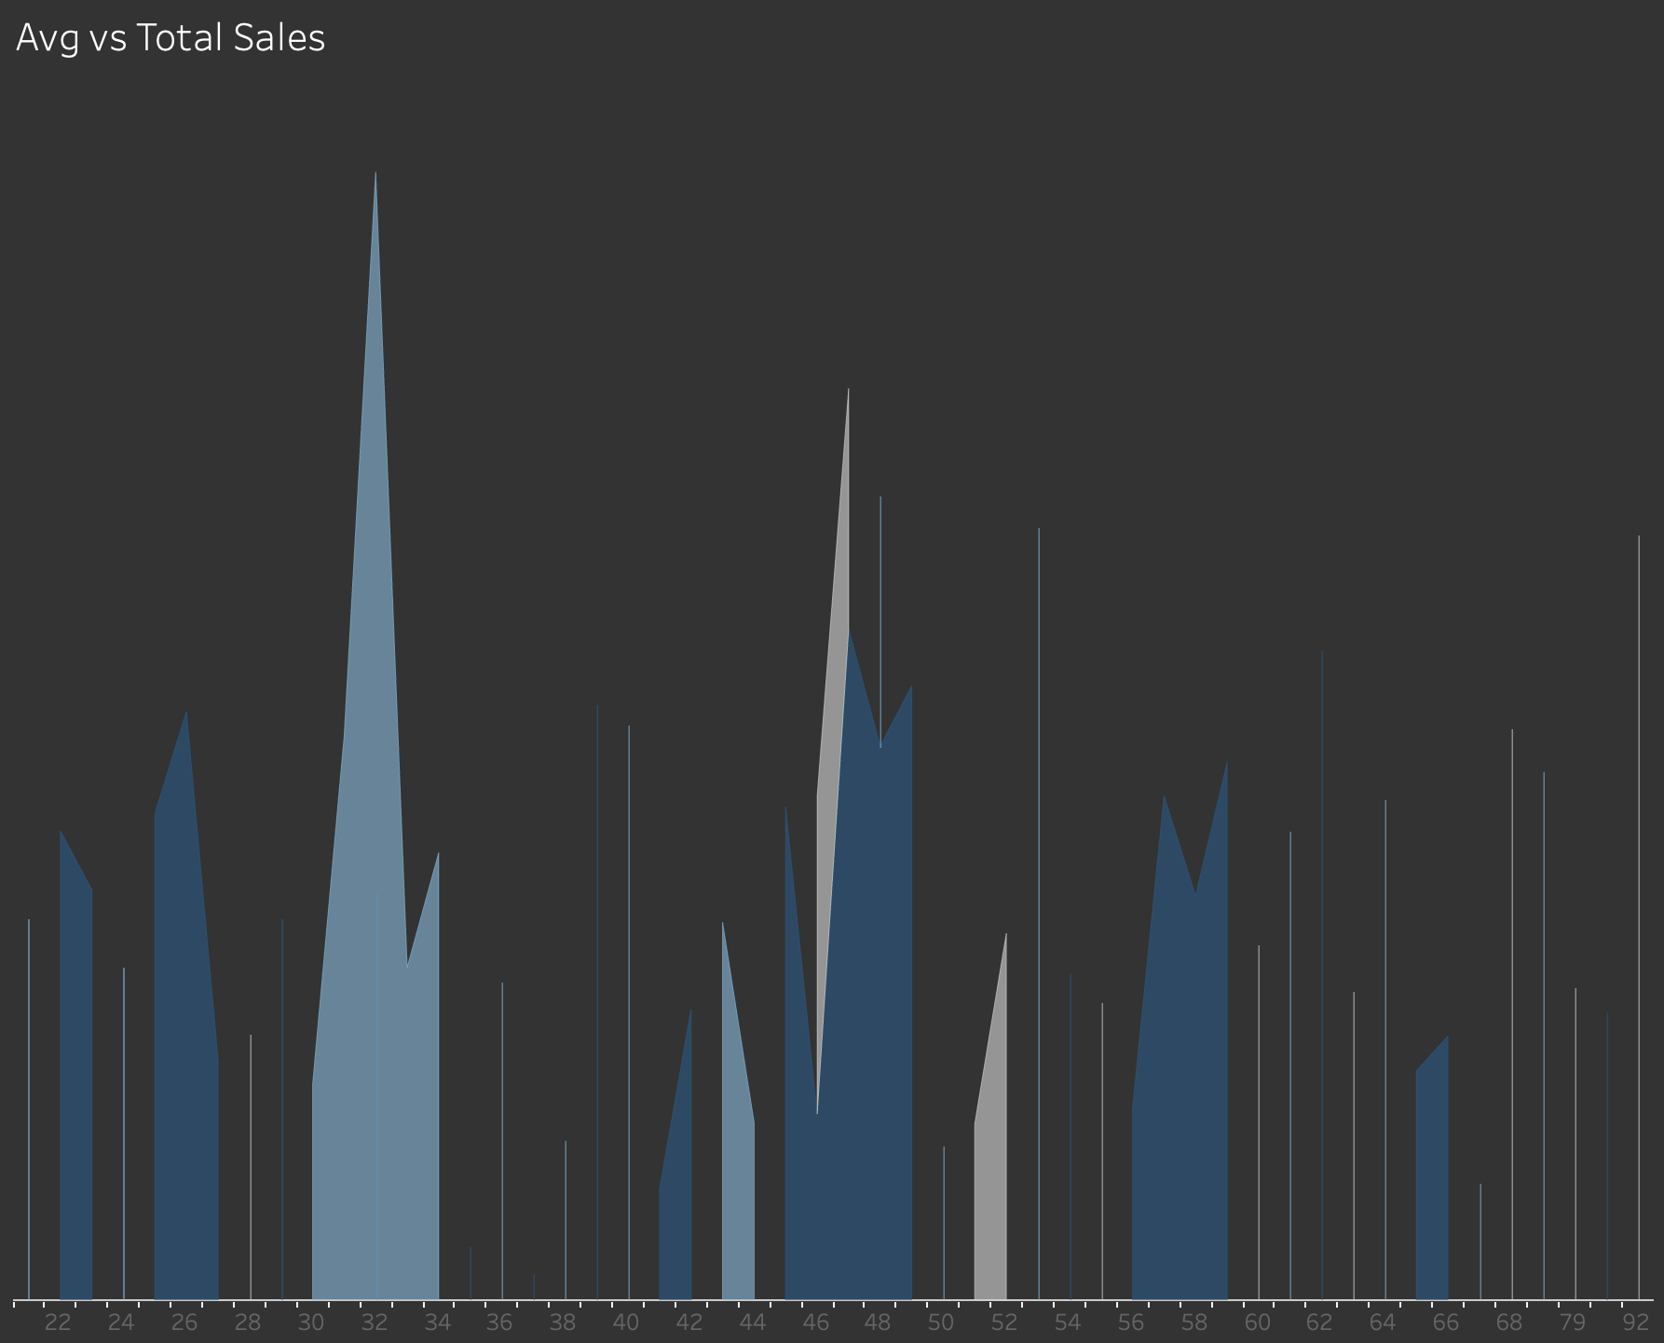
Data Exploration
Wealth Segmentation by age category:
In all age categories the largest number of customers are classified as ‘Affluent Customer’.
The next category is the ‘High Net Worth’.
The ‘Affluent Customer’ can outperform the ‘Mass Customer’ in the 45-49 age group.

Slide 8
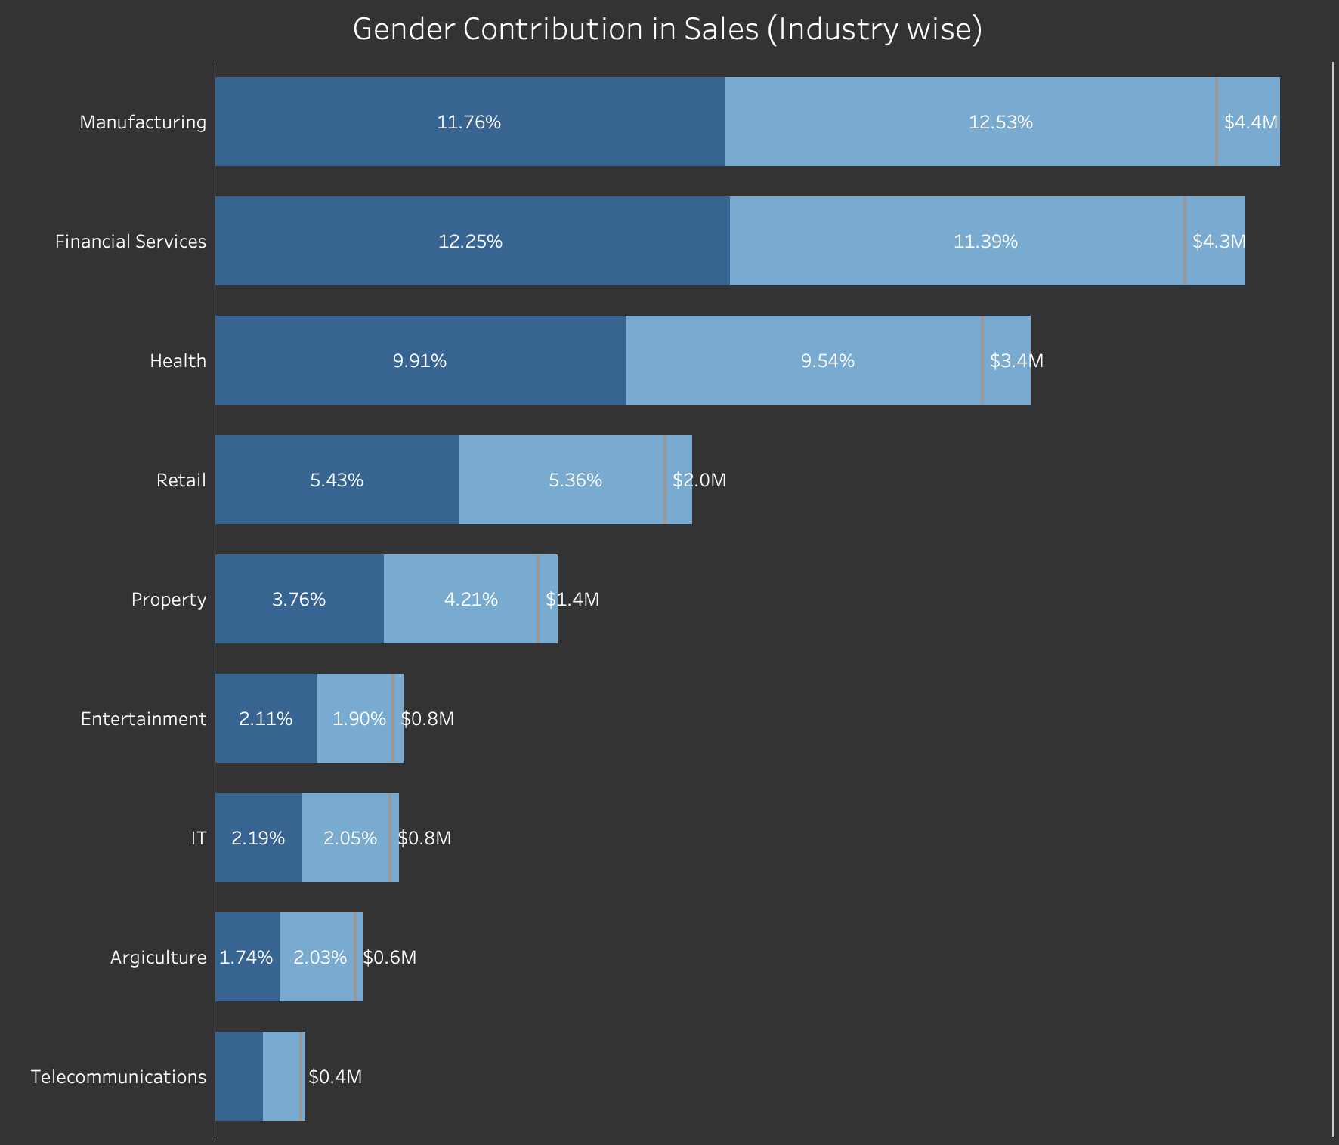
Interpretation
Gender Contribution in Sales (Industry wise):
Numerically, female purchases more than males.
11%-13% customers in Manufacturing and Financial services.
The smallest number of customers are in Agriculture and Telecommunications at 2%.
Over the last 3 years females bike related purchases than males.

Slide 9
Summary
Customer’s purchase profit and sales
Average Profit%: 552
No. of Customers: 3489
Product sold: 19968
Total Profit: $11Ms

Slide 10
Thank you

